Slide 1
ECMAScript 6
ESNext
Notes:
https://codeburst.io/es6-tutorial-for-beginners-5f3c4e7960be

Slide 2
Overview
Finalized on June 2015
Adds significant new syntax constructs
Browser support is not complete
Can be transpiled back to ES5
Notes:
Transpile = little less than compiling.

Slide 3
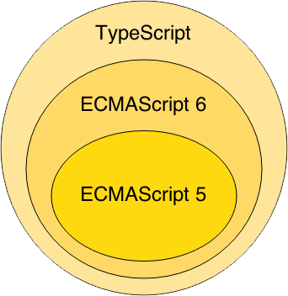
ES6
ES6 superset of ES5
Transpile ES6 to ES5
Notes:
`Wat zijn de voordelen van typescript

Slide 4
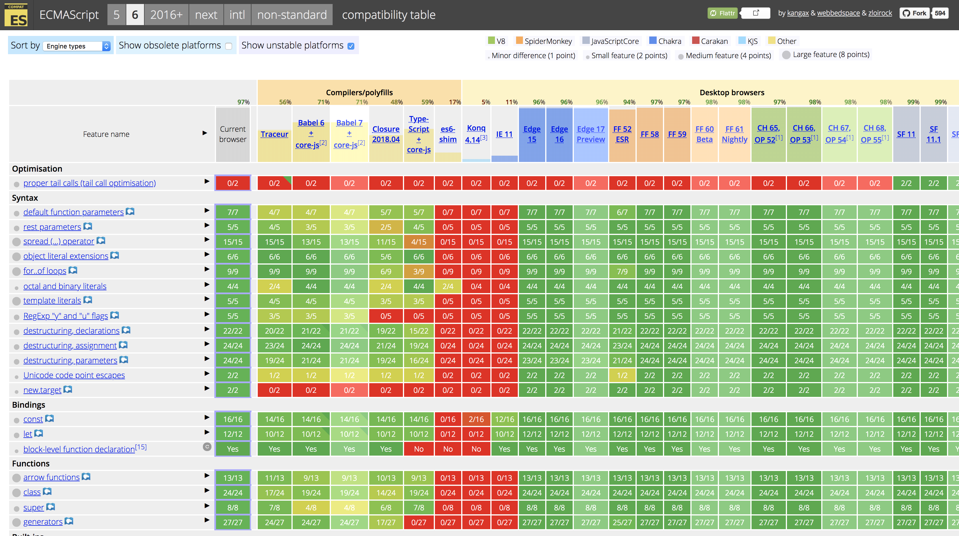
ES6 Support
http://kangax.github.io/compat-table/es6/

Slide 5
Let’s dive into it!
Notes:
https://www.youtube.com/watch?v=WZQc7RUAg18

Slide 6
Variables
No need for “var” anymore

Slide 7
Variables
Block scoped instead of function scoped
const
let
Notes:
Hoisting: is make a variable available everywhere within a function.
const: variable can’t be assigned again vs var
let: variable can be assigned again vs var

Slide 8
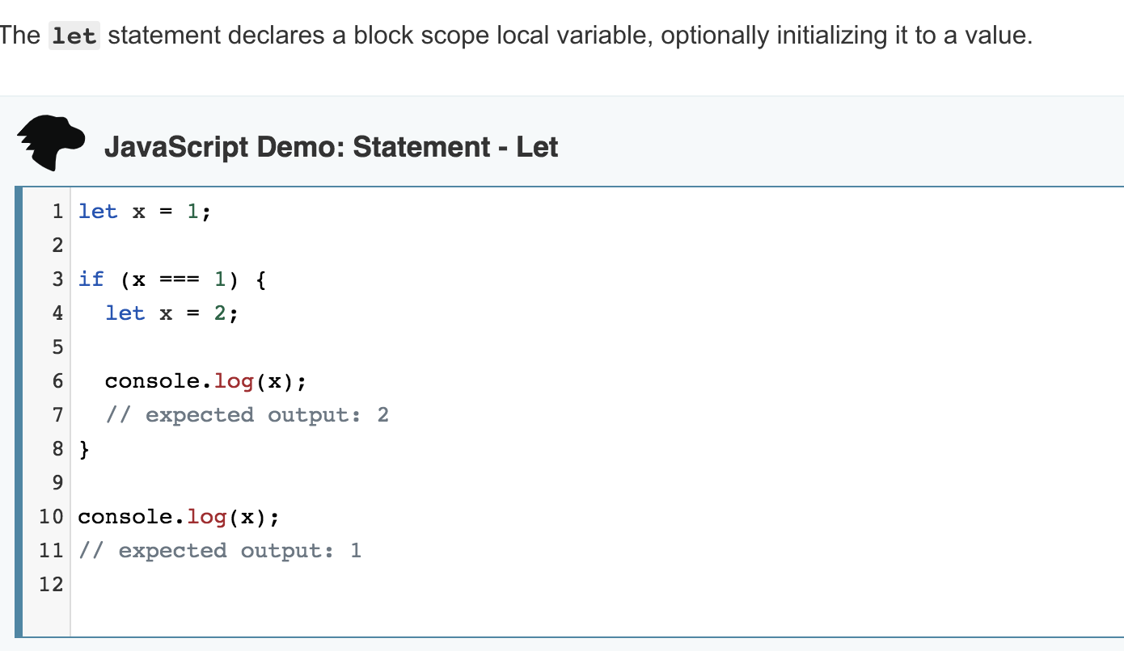

Slide 9
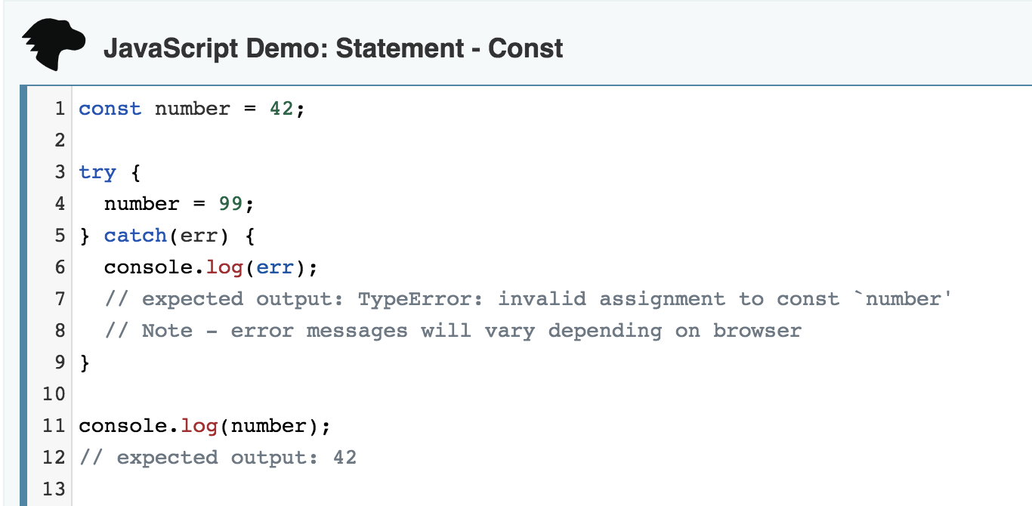

Slide 10
Example
function() {
const x = "x";
x = "something else";
// Uncaught TypeError: Assignment to constant variable.
const y = {y: 'y'};
y.y = 'x'; // this works
}
Notes:
‘const’ works only one level deep.
Object.freeze
The Object.freeze() method freezes an object: that is, prevents new properties from being added to it; prevents existing properties from being removed; and prevents existing properties, or their enumerability, configurability, or writability, from being changed, it also prevents the prototype from being changed. The method returns the passed object.

Slide 11
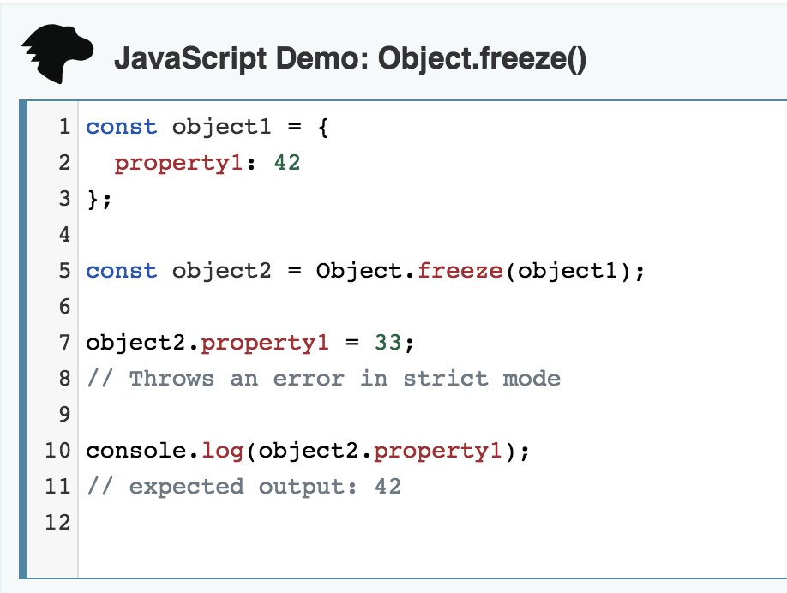

Slide 12
Arrow functions
lambda’s, anonymous inner classes

Slide 13
Arrow functions
// Old Syntax const foo = function foo() { console.log("Hello World..!"); }
// New Syntax
const foo = () => { console.log("Hello World..!"); }

Slide 14
Arrow functions
There are two parts of the syntax.
let newOne = ()
2. => {}
Notes:
The first part is just declaring a variable and assigning the function (i.e) () to it. It just says the variable is actually a function.
Then the second part is declaring the body part of the function. The arrow part with the curly braces defines the body part.

Slide 15
Arrow functions
evens = {2,4,6,8,10}
odds = evens.map(v => v + 1)
pairs = evens.map(v => ({ even: v, odd: v + 1 }))
nums = evens.map((v, i) => { return v + i;})
Instead of:
odds = evens.map(function (v) { return v + 1; });
pairs = evens.map(function (v) { return { even: v, odd: v + 1 }; });
nums = evens.map(function (v, i) { return v + i; });

Slide 16
Arrow functions
Work the same as Java 8 lambda’s Except for:
Function is not bound to interface implementation
Arrow head is -> instead of =>

Slide 17
Arrow functions
function Person(){
this.age = 0;
setInterval(() => {
this.age++; // |this| properly refers to the person object
}, 1000);
}
var p = new Person();

Slide 18
Default parameter values
let increment = (test = 1) => test + 1;
increment(2); // 3
increment(); // 2
increment(undefined); // 2
Notes:
// or
(test = 1) = means that 1 will be the default value if no parameter.
You could also just make a function:
let bicrement = function(test = 2) { return test + 2;}

Slide 19
Spread operator
function f (x, y, ...a) {
return (x + y) * a.length
}
f(1, 2, "hello", true, 7) === 9

Slide 20
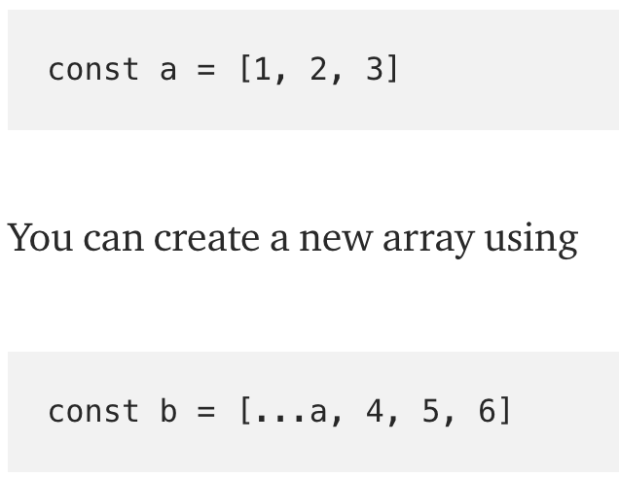

Slide 21
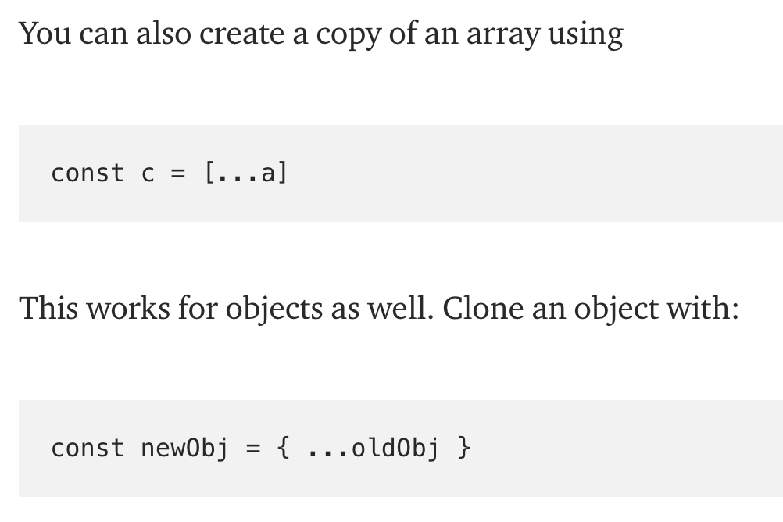

Slide 22
Template literals
let x = `testing ${1 + 1}`
let y = `hello world ${x}`
instead of:
let x = “testing” + (1 + 1)

Slide 23
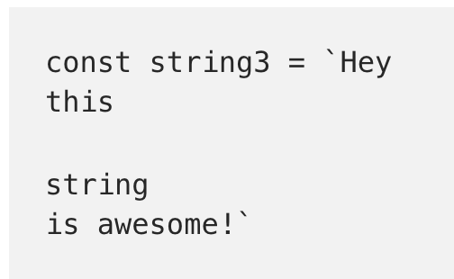
Template literals

Slide 24
Enhanced Object properties
const x = 2, y = 3;
let obj = { x, y };
// is equivalent to:
let obj = { x: x, y: y };

Slide 25
Enhanced Object properties
// Computed property names
let property = 'foo';
let obj = {
[property]: 'hey',
['b' + 'ar']: 'there'
};

Slide 26
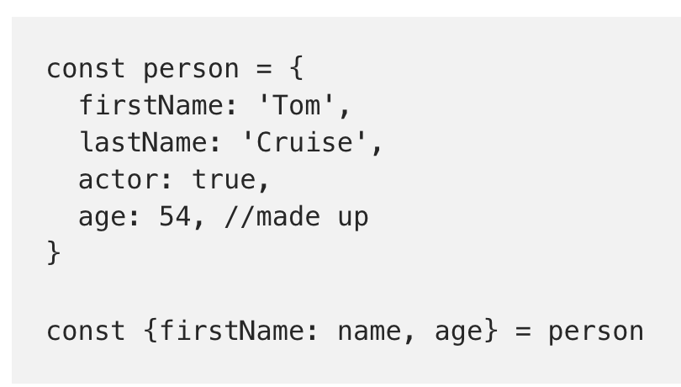
Destructuring Assignment
Notes:
MDN: The destructuring assignment syntax is a JavaScript expression that makes it possible to extract data from arrays or objects into distinct variables.

Slide 27
Classes
class Shape {
constructor (id, x, y) {
this.id = id;
this.x = x;
this.y = y;
}
size () {
return this.x * this.y;
}
}
let square = new Shape('test', 3, 3)
square.size();

Slide 28
Classes
class Square extends Shape {
constructor (id, length) {
super(id, length, length);
}
}
new Square('test', 3).size();

Slide 29
Classes
class Square extends Shape {
constructor (id, x) {
super(id, x, x);
}
static calcSize(length) {
return length * length;
}
}
Square.calcSize(3);

Slide 30
Component
Notes:
A component may be a variable, function, class and so forth

Slide 31
Modules
Notes:
A module is a collection of small independent units (components) that we can reuse in our application.

Slide 32
What’s the purpose?
Encapsulate behaviour
Easy to work with
Easy to maintain
Easy to scale

Slide 33
Modules
//------ module.js ------
export const sqrt = Math.sqrt;
export function square(x) { return x * x; }
export function diag(x, y) { return sqrt(square(x) + square(y)); }
//------ program.js ------
import { square, diag } from ‘module';
console.log(square(11)); // 121
console.log(diag(4, 3)); // 5
Notes:
export compare to public in Java .
http://2ality.com/2014/09/es6-modules-final.html

Slide 34
And what can we actually export?
A variable
An object literal
A class
A function
Notes:
verything that can be exported by the export statement is a component

Slide 35
Map
var newMap = new Map( ); newMap.set('name', 'John'); newMap.set('id', 2345796); newMap.set('interest', ['js', 'ruby', 'python']);
newMap.get('name'); // John newMap.get('id'); // 2345796 newMap.get('interest'); // ['js', 'ruby', 'python']

Slide 36
Set
var set = new Set( ); set.set('name', 'John'); set.set('name', 'Andy'); set.set(1, 'number one'); set.set(NaN, 'No value');
set.get('name'); // Andy. Note John is replaced by Andy. set.get(1); // number one set.get(NaN); // No value

Slide 37
And many many more things
Symbols, generators, Weak Link datasets
A lot of extensions on built-ins
Learn more about this, scan this page: http://es6-features.org/

Slide 38
Opdracht ES6
Change your solutions for week 1:
You are not allowed to use ‘var’ or ‘function’.
Only use ‘const’ instead of ‘let’
HINT: https://codeburst.io/es6-tutorial-for-beginners-5f3c4e7960be

